Slide 1
AI Contract Hub
Bilingual Initial Review of Service Agreements
DEPI Capstone Project
Applied AI Agents for Legal Professionals
CAI5_IND6_G1 • Group (2)
Committee Presentation / October 2026
AI CONTRACT HUB
01

Slide 2
Project team
CAI5_IND6_G1 Group (2)
01
Eman Mohamed Mahmoud Khodry
02
Ahmed Abdullah Ali Elbana
03
Ahmed Saied Ali Elmezayen
04
Mazen Moustafa Elsayed Mohammed
05
Mohamed Alm ElDin Ahmed Ammar
06
Fady Medhat Beshay Ebrahim
AI CONTRACT HUB
02

Slide 3
The review challenge
Time-consuming review
Manual preparation and contract review take significant time.
Human error and omissions
Important clauses and risks may be overlooked.
Misinterpretation
Complex wording may lead to incorrect interpretations.
Understanding the issue
Identifying the underlying problem requires contractual and business context.
AI CONTRACT HUB
03

Slide 4
The review challenge
Precise alternative drafting
Suggested wording must address the issue without creating ambiguity.
Limited productivity
Repetitive tasks limit the number of contracts reviewers can handle.
Usability and prompting barriers
Complex tools and unclear prompts make AI-assisted review harder to use.
AI CONTRACT HUB
04

Slide 5
Project scope
Supported inputs
Review deliverables
PDF and DOCX documents
Complete contract text
Separate contractual clauses
Risk assessment
Practical recommendations
Proposed contractual wording
Initial review with qualified lawyer approval
AI CONTRACT HUB
05

Slide 6
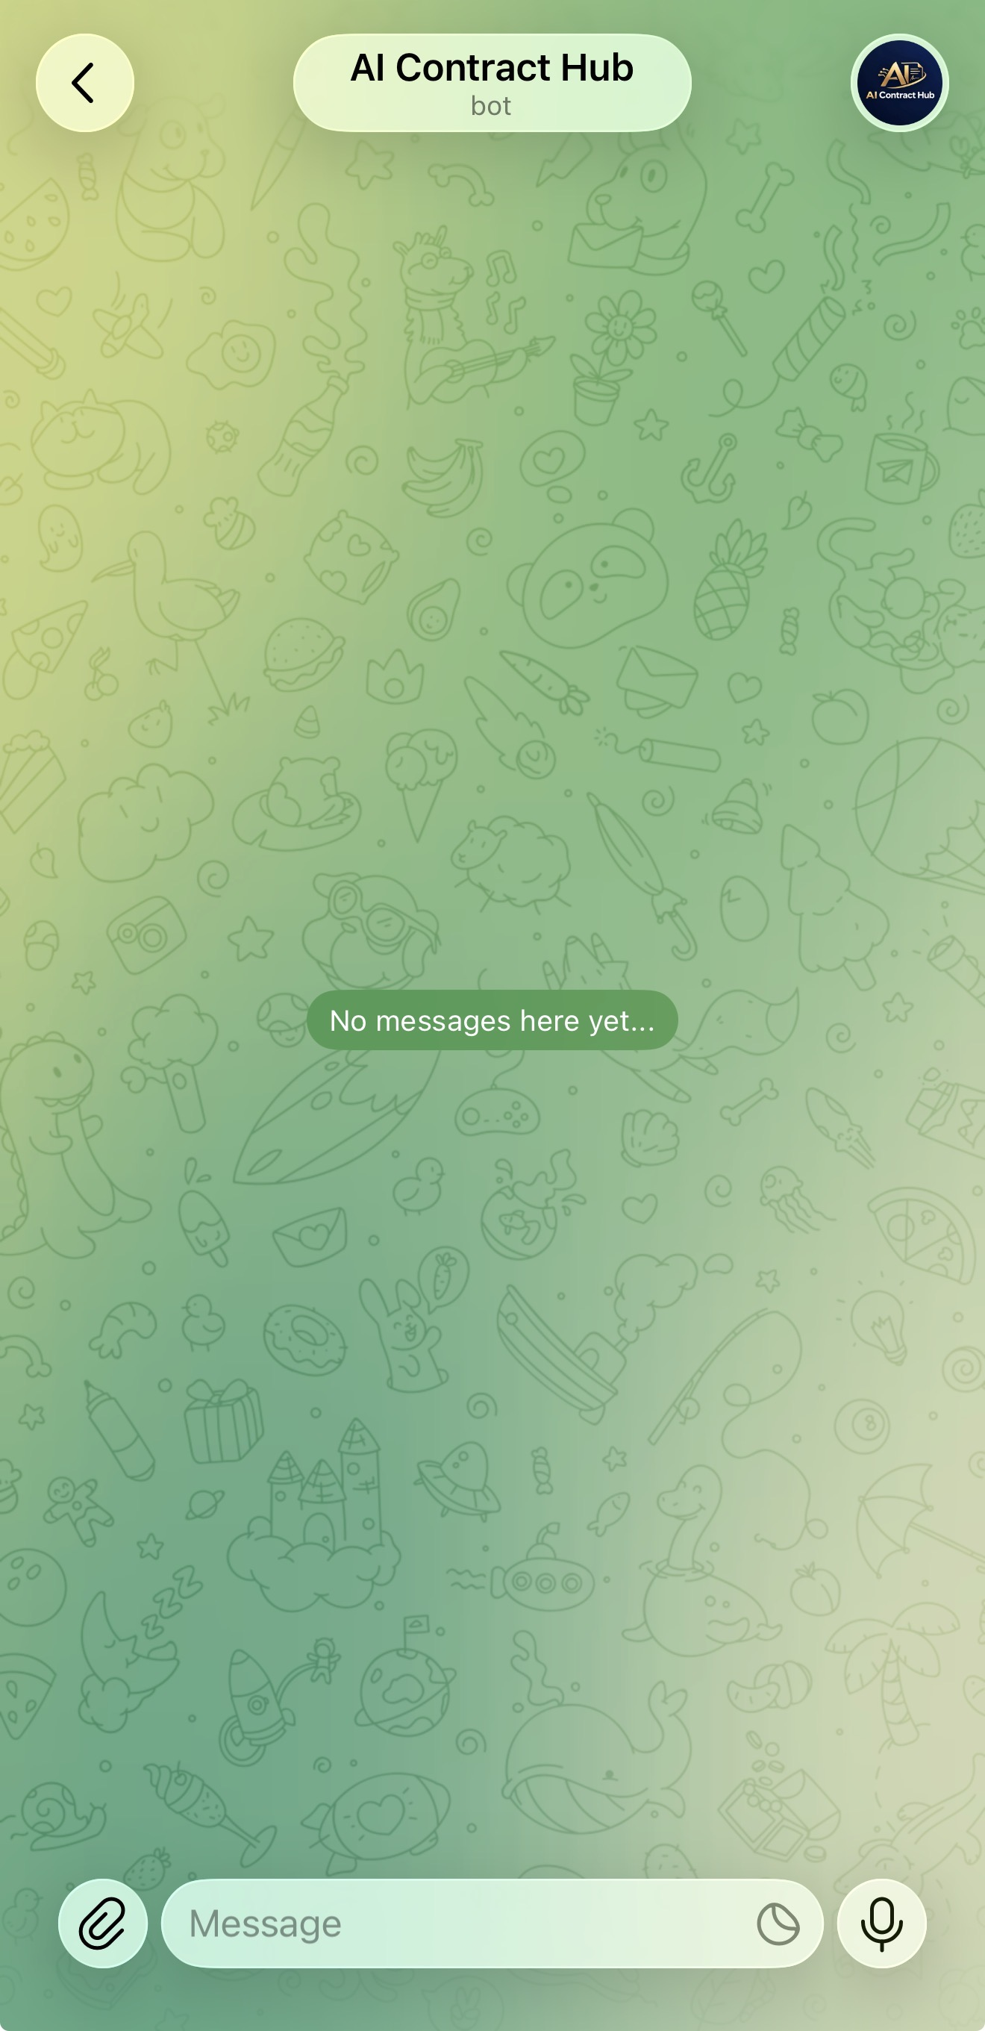
The user journey
01 Submit
Send a message, PDF, or DOCX.
02 Process
Route the input and prepare the review.
03 Review
Receive findings for legal assessment.
Telegram entry screen
AI CONTRACT HUB
06

Slide 7
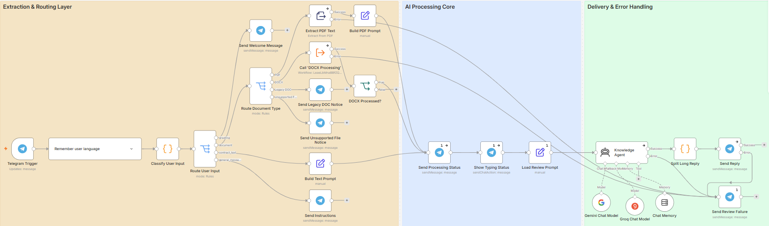
Workflow architecture
Final workflow with saved language preference and review prompt loading
AI CONTRACT HUB
07

Slide 8
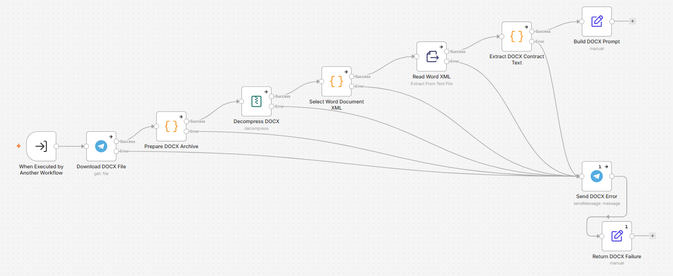
DOCX processing workflow
Download, extract XML, prepare the review prompt, and route processing failures
AI CONTRACT HUB
08

Slide 9
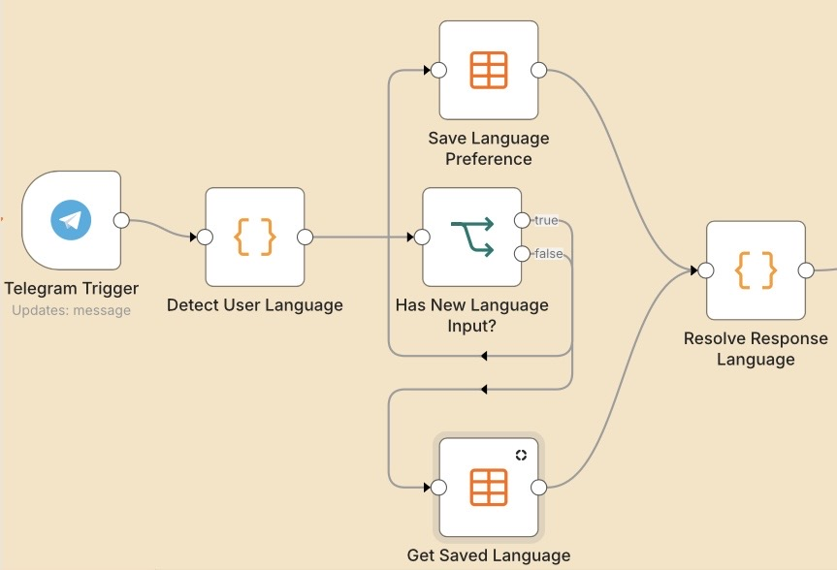
Language preference management
Detect
Read the language signal in the incoming message.
Save or retrieve
Store a preference or reuse the saved chat language.
Resolve
Pass one response language to the review workflow.
AI CONTRACT HUB
09

Slide 10
The twelve-rule legal checklist
Commercial terms | Risk allocation | Legal framework
01 Parties | 05 Termination | 09 Intellectual property
02 Scope of services | 06 Limitation of liability | 10 Data protection
03 Payment | 07 Indemnity | 11 Governing law
04 Term and renewal | 08 Confidentiality | 12 Dispute resolution
Additional material issues receive separate observations
AI CONTRACT HUB
10

Slide 11
AI CONTRACT HUB
Problems and workflow solutions
REVIEW CHALLENGE | AI CONTRACT HUB SOLUTION | PRACTICAL BENEFIT
Time-consuming review | Extracts PDF/DOCX text and prepares a structured initial review. | Less manual preparation and a faster first review draft.
Human error and omissions | Applies a 12-rule checklist and flags potential gaps with clause references. | More consistent coverage and easier verification by reviewers.
Misinterpretation | Explains clauses with original quotations and translations into the response language. | Clearer understanding and easier comparison with the source.
Understanding the issue | Links each finding to the affected party, contractual context and practical impact. | Better-informed prioritization and negotiation decisions.
Precise alternative drafting | Suggests issue-specific replacement wording in Arabic or English for lawyer approval. | A practical drafting starting point and less initial rewriting.
Limited productivity | Automates extraction, initial analysis and delivery of organized findings. | More reviewer time for complex issues and professional judgment.
Usability and prompting barriers | Uses Telegram uploads or pasted text, saved language preferences and built-in prompts. | A familiar interface with less prompt-writing effort.
All findings and proposed clauses require qualified human review.
11

Slide 12
Thank you
Questions and discussion
AI Contract Hub
CAI5_IND6_G1 Group (2)
AI CONTRACT HUB
12

